Slide 1
5.5 Variation and Evolution

Slide 2
What is variation?
Define Variation…
What controls variation in a population?
Most characteristics are controlled by multiple genes
Any character that shows a gradation from one extreme found in the population to the other is called continuous variation

Slide 3
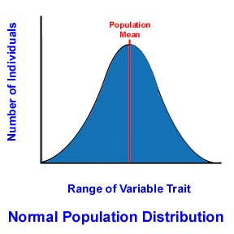
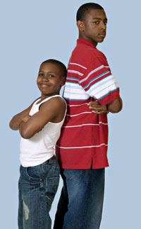
Continuous Variation
Can you think of an example?
height
weight
heart rate
finger length
leaf length
From BBC Bitesize

Slide 4
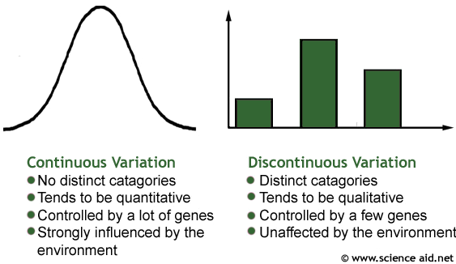
Discontinuous Variation
Discontinuous variation is variation that has distinct groups for organisms to belong to. A bar graph is used to represent discontinuous variation.
tongue rolling
finger prints
eye colour
blood groups

Slide 5
Heritable traits
Are all characteristics heritable?
There are examples of both heritable and non-heritable variation
Often characteristics that show continuous variation have both a genetic and environmental input into an individuals phenotype.

Slide 6
Competition
What is competition?
What do individuals have to compete for?
Who are they competing with?
Intra-specific competition
Inter-specific competition
Success in competition leads to increased breeding success and survival of individuals and ultimately species
It leads to Natural Selection within populations…

Slide 7
Natural Selection

Slide 8
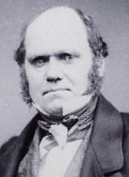
Natural Selection
Natural selection is one of the basic mechanisms of evolution
(along with mutation, migration and genetic drift)
Darwin's grand idea of evolution by natural selection is relatively simple but often misunderstood
1809-1882

Slide 9
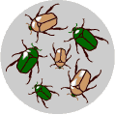
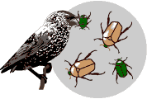
There is variation in traits. For example, some beetles are green and some are brown.
There is differential reproduction. Since the environment can't support unlimited population growth, not all individuals get to reproduce to their full potential.
In this example, green beetles tend to get eaten by birds and survive to reproduce less often than brown beetles do.

Slide 10
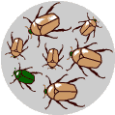
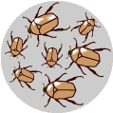
There is inheritance of traits. The surviving brown beetles have brown baby beetles because this trait has a genetic basis.
End result: The more advantageous trait, brown coloration, which allows the beetle to have more offspring, becomes more common in the population. If this process continues, eventually, all individuals in the population will be brown.

Slide 11
If you have variation, differential reproduction, and heredity, you will have evolution by natural selection as an outcome. It is as simple as that.

Slide 12
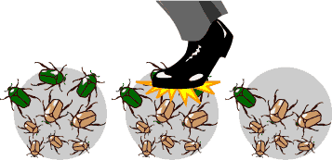
Genetic Drift
In each generation, some individuals may, just by chance, leave behind a few more descendents (and genes, of course!) than other individuals.
The genes of the next generation will be the genes of the "lucky" individuals, not necessarily the healthier or "better" individuals.
That, in a nutshell, is genetic drift. It happens to ALL populations — there's no avoiding the vagaries of chance.

Slide 13
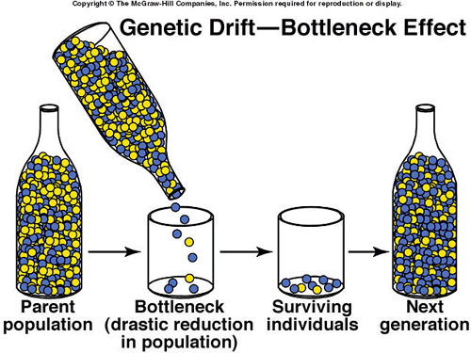

Slide 14
Mutations
Mutations cause small changes on genes
They are the source of variation on which natural selection acts
Mutations increase the number of alleles
(therefore size of gene pool)
A gene mutation may change an aspect of the organism.
If this is advantageous to fitness, the frequency of that allele in the population will increase.

Slide 15
Small populations
Large populations have large gene pools
So chance of losing an allele from the pool (by drift) is lessened.
E.g. 10% of the pop have an allele
If pop =10 only 1 has it
If pop = 1000, 100 have it, less likely to die

Slide 16
Similar effect happens when individuals migrate and set up a new population
Alleles they carry may be a random selection of the gene pool
But if one or two carry a rare gene, as the new population is small it will represent a large % and will be amplified as the population grows:
Founder Effect

Slide 18
Evolution in Action

Slide 19
Adapting to change
Individuals that are not well adapted may die
‘Survival of the fittest’
Natural selection
Result of changing selection pressures

Slide 20
Adapting to change
Malpeque Bay Oysters are a classical example.
Huge oyster population
In 1915, disease hit, pus filled blisters all but wiped out the oysters.
Some oysters had a resistant allele, they survived to breed
Their offspring have the allele… these breed… and the allele spreads through the population
Now oysters are as prolific as they ever were.

Slide 21
Selection
The oysters of Malpeque Bay are a good example of directional selection:
natural selection resulting in a change of phenotype to a more advantageous one

Slide 22
Directional selection

Slide 23
Selection
Diversifying selection increases the diversity of a population.
It can lead to new species.
It happens when conditions are very variable and small subpopulations evolve different phenotypes suiting their surroundings

Slide 24
Diversifying selection

Slide 25
Balancing Selection
this keeps an allele in the population even though it would appear to be disadvantageous.
eg sickle cell anaemia
Called heterozygous advantage or hybrid vigour

Slide 26
Balancing selection

Slide 27
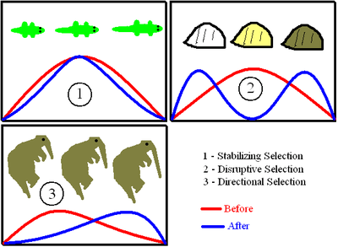

Slide 28
Peppered Moth
Sometimes known as Industrial Melanism
Moths tended to be a pale colour – dark versions were rare
Moths liked to live on trees, they blended in with the pale bark
During the 19th century, sooty smoke from coal burning furnaces killed the lichen on trees and darkened the bark.

Slide 29
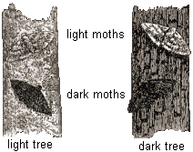

Slide 30
dark coloured moths were harder to spot on ‘new’ dark coloured trees
less got eaten by birds
Pale coloured moths were easy to spot and got eaten
Over generations, the environment continued to favour darker moths. As a result, they progressively became more common.

Slide 31
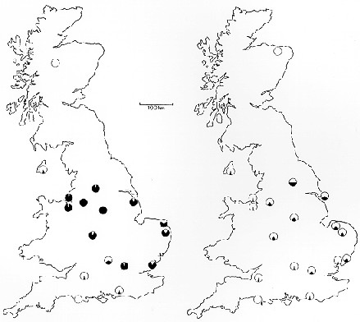
1956
1996

Slide 32
By 1895, 98% of the moths in the vicinity of English cities like Manchester were mostly black.
Since the 1960's, air pollution controls have significantly reduced pollution
As a result, lichen has grown back, making trees lighter in colour.

Slide 33
Now, natural selection favours lighter moth varieties so they have become the most common.

Slide 34
Darwin’s finches
The Galápagos Islands have species found in no other part of the world
Darwin was struck by the fact that the birds were slightly different from one island to another
He realised that the key to why this difference existed was connected with the fact that the various species live in different kinds of environments.

Slide 35
Darwin identified 13 species of finches in the Galápagos Islands. This was puzzling since he knew of only one species of this bird on the mainland of South America, nearly 600 miles to the east, where they had all presumably originated

Slide 36
He observed that the Galápagos species differed from each other in beak size and shape. He also noted that the beak varieties were associated with diets based on different foods.

Slide 37
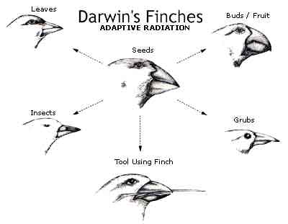
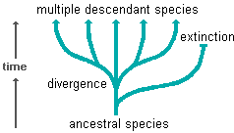
He concluded that when the original South American finches reached the islands, they dispersed to different environments where they had to adapt to different conditions. Over many generations, they changed anatomically in ways that allowed them to get enough food and survive to reproduce.

Slide 38
Sexual Selection
Selection for features that give reproductive success is known as sexual selection.
In many species there are clear anatomical adaptations for attracting a mate.

Slide 39
Isolating Mechanisms
Different species evolve as a result of isolation
This stops mating between the populations therefore geneflow is restricted.
There are a number of ways this can happen...

Slide 40
Geographical isolation
a physical barrier like a river or mountain range separates populations.
Ecological isolation
two populations inhabit the same area but develop preferences for different parts of it

Slide 41
Seasonal isolation
timing of flowering or sexual receptiveness drifts away from the rest of the group
May result in two groups reproducing at different times.
Behavioural isolation
changes occur in courtship, display or mating pattern so some do not recognise as mate.

Slide 42
Mechanical isolation
mutation may occur that changes genitalia of animals so they can only mate with a subset of the population
e.g. Changes relationship between stigma and stamen so pollination is unsuccessful

Slide 43
Speciation
Allopatric speciation takes place when the populations are separated in some way
Sympatric speciation occurs when populations are still close to each other.

Slide 44
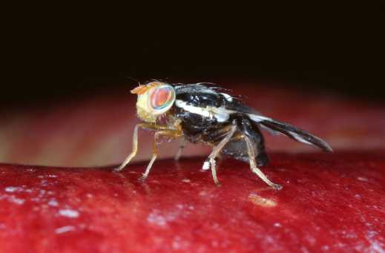
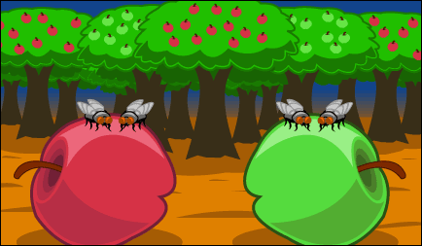
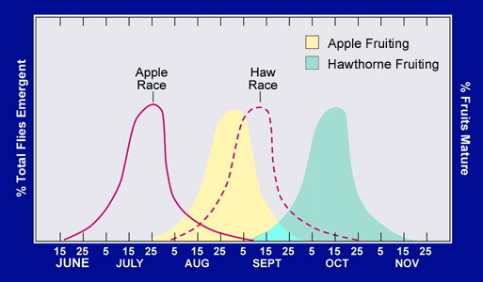
Rhagoletis pomonella fruitfly that only lays eggs on hawthorn.
150yrs ago lots of apple trees were planted, close relatives to hawthorn
Some of the flies laid eggs on the apples, their offspring returned to do the same...
http://www.sciencecases.org/maggot_fly/maggot_fly.asp

